Slide 1
​https://www.cnn.com/2018/03/25/world/orange-snow-russia-trnd/index.html

Slide 2
Terrain Analysis
Today: Visibility Analysis
Thursday: Hydrological Analysis

Slide 3
Topics
Viewshed
Single Observer
Multiple observer
Visibility
Binary
Frequency

Slide 4
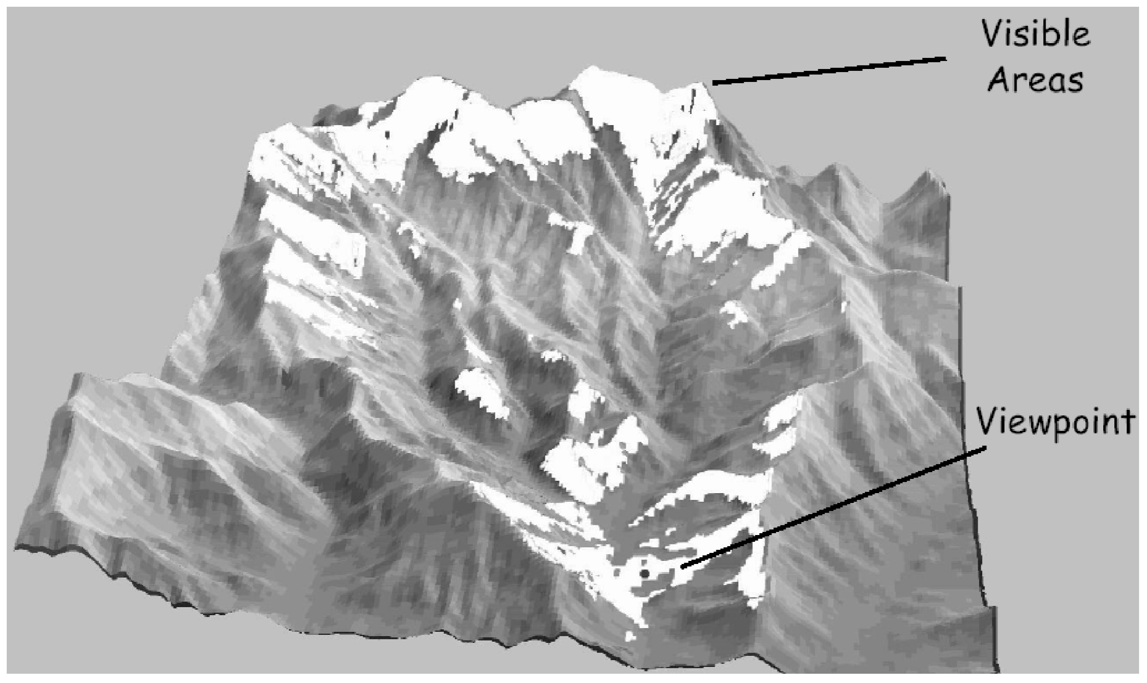
Viewshed
The area on a surface which is visible from an observer

Slide 5
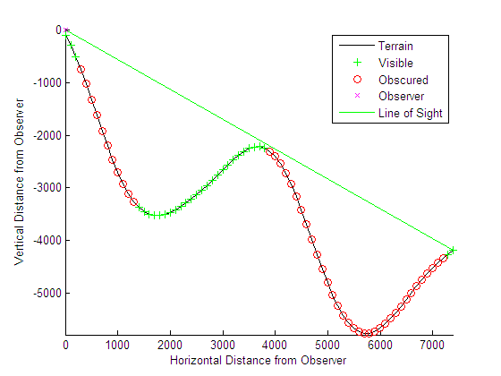
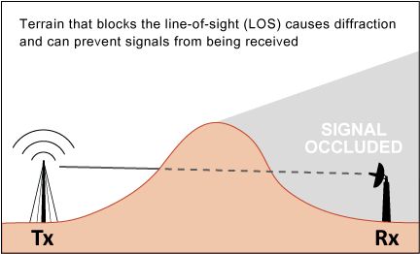
Line of sight
A straight line connects the observation point and the target point without interrupted by terrain at any location in between.
If a line-of-sight exits, the target point is visible from the observation point.

Slide 6
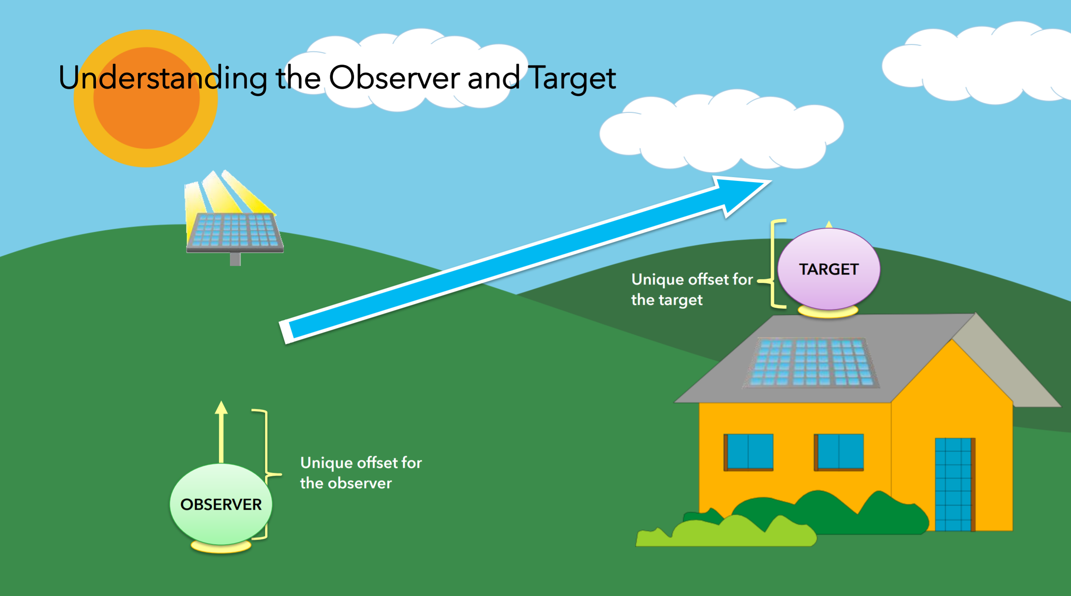
Notes:
http://proceedings.esri.com/library/userconf/proc17/tech-workshops/tw_402-493.pdf

Slide 7
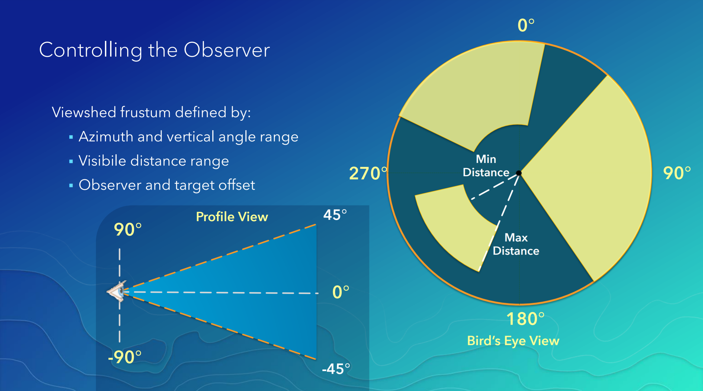
Visibility Analysis Parameters

Slide 8
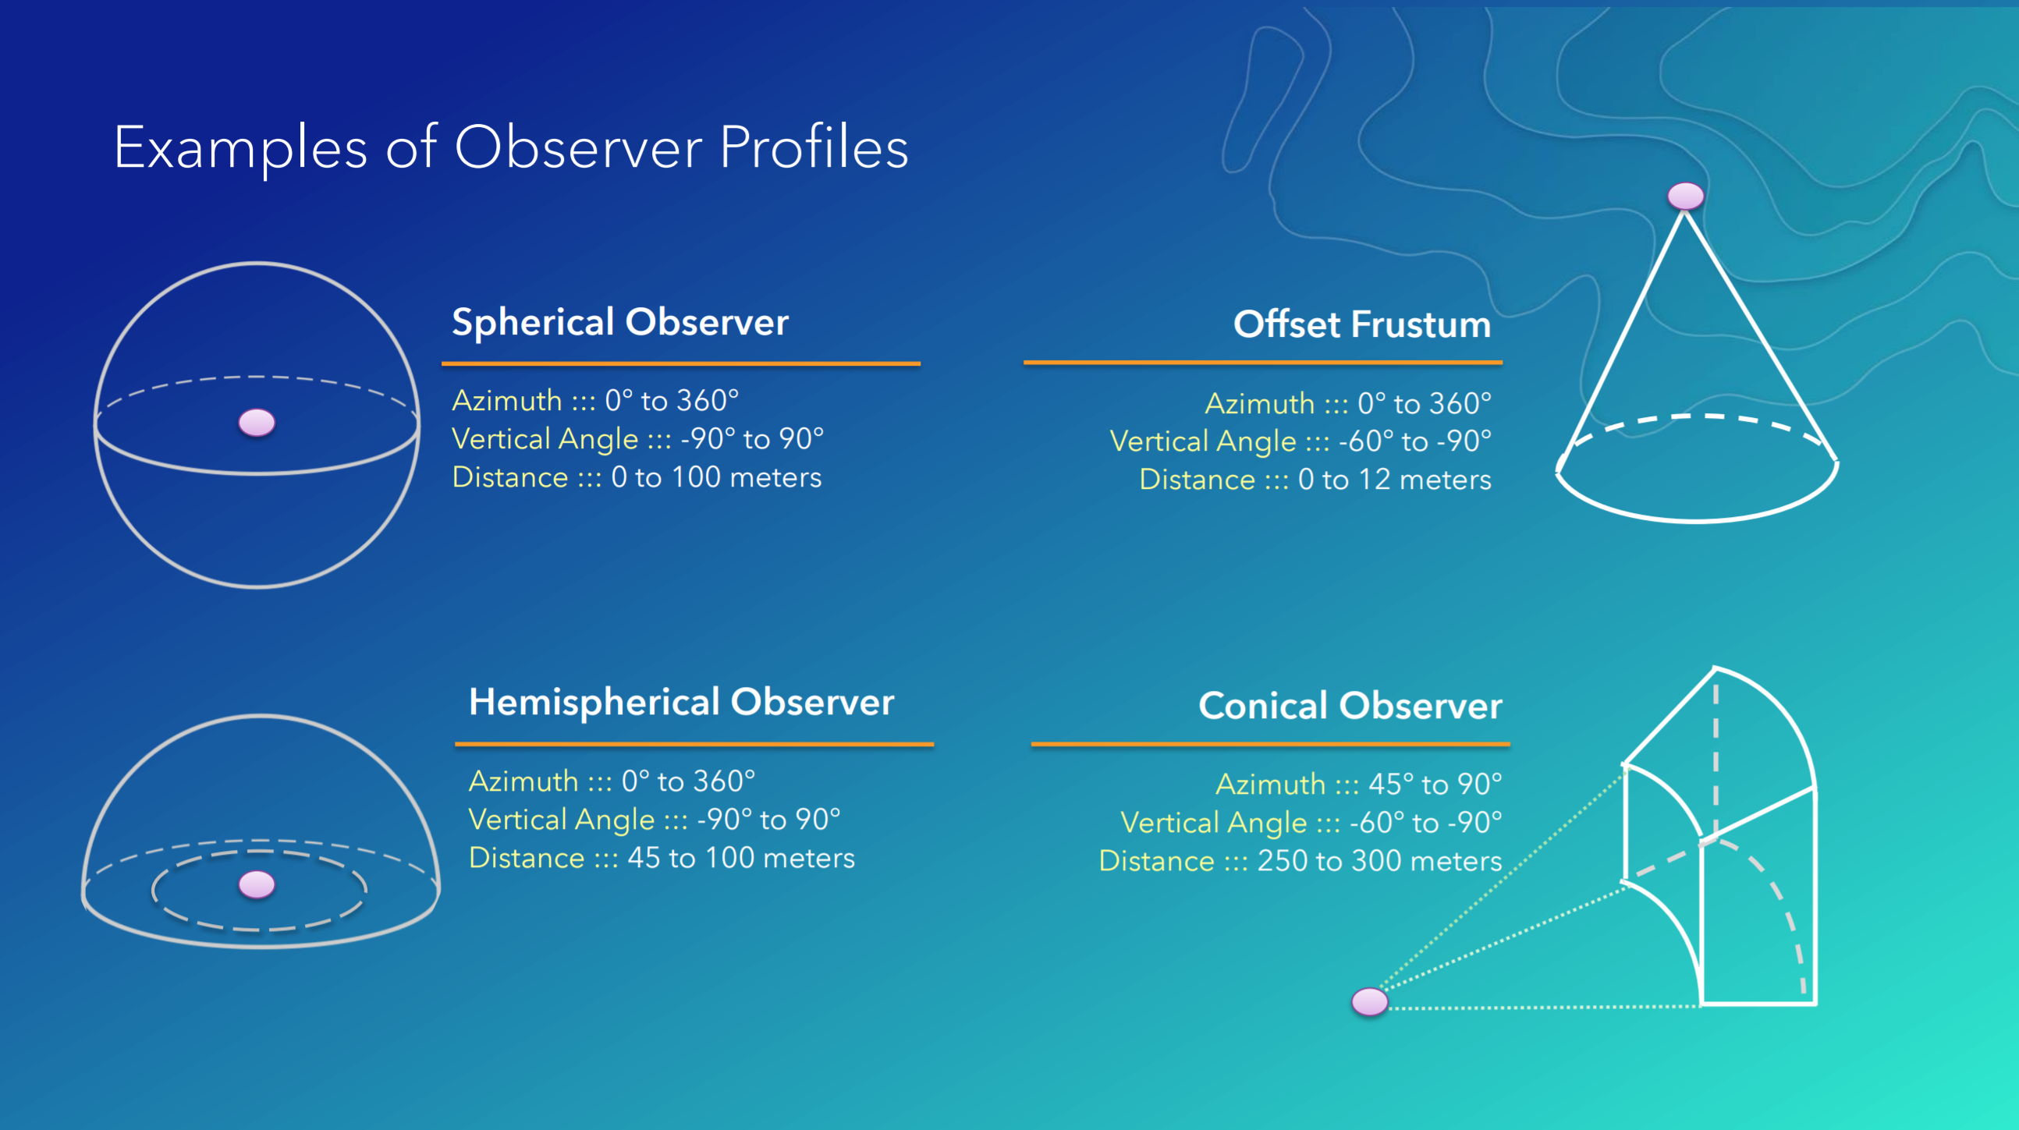

Slide 9
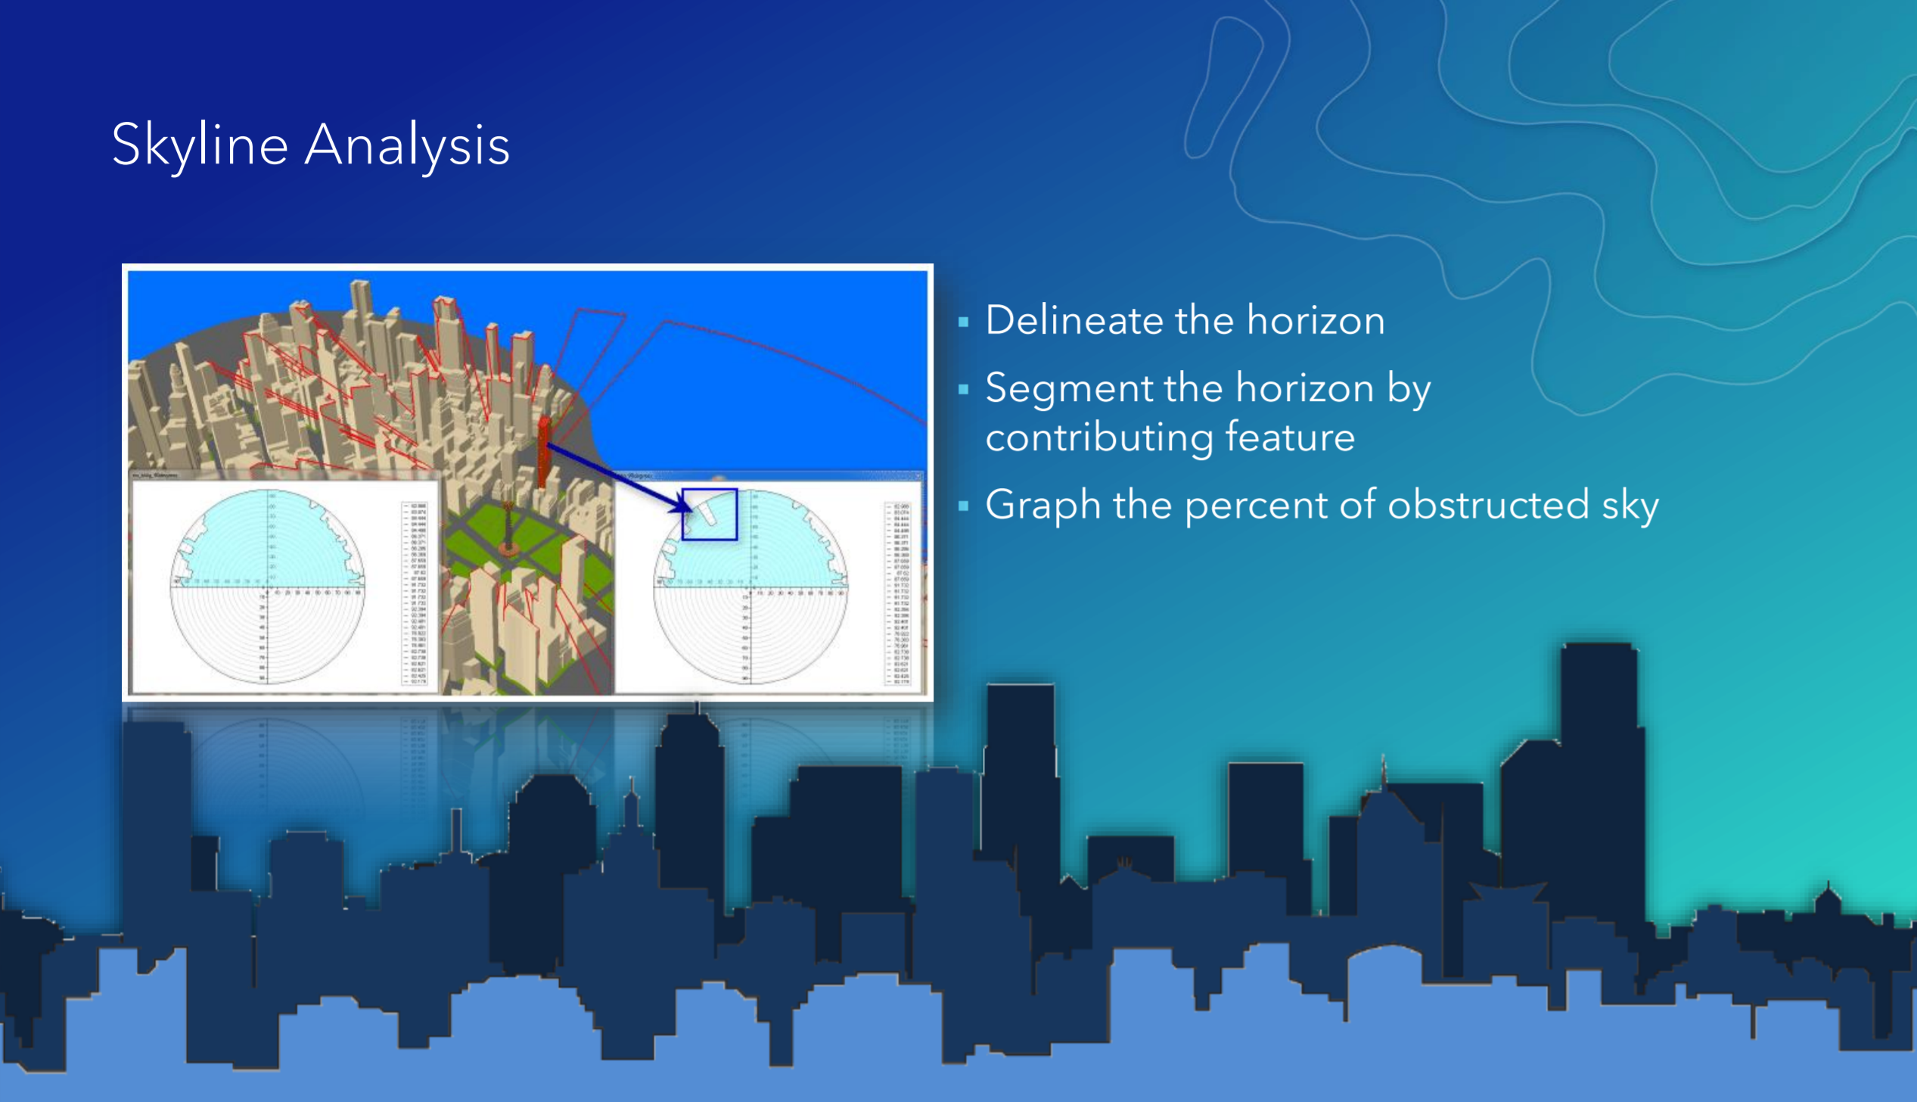

Slide 10
Observer
The observer’s location is stored in a shapefile
•Parameters controlling viewshed delineation are stored as the attributes of points
OFFSETA,
OFFSETB,
AZIMUTH1,
AZIMUTH2,
VERT1,
VERT2,
RADIUS1,
RADIUS2
Field names must be exact the same as the parameter names

Slide 11
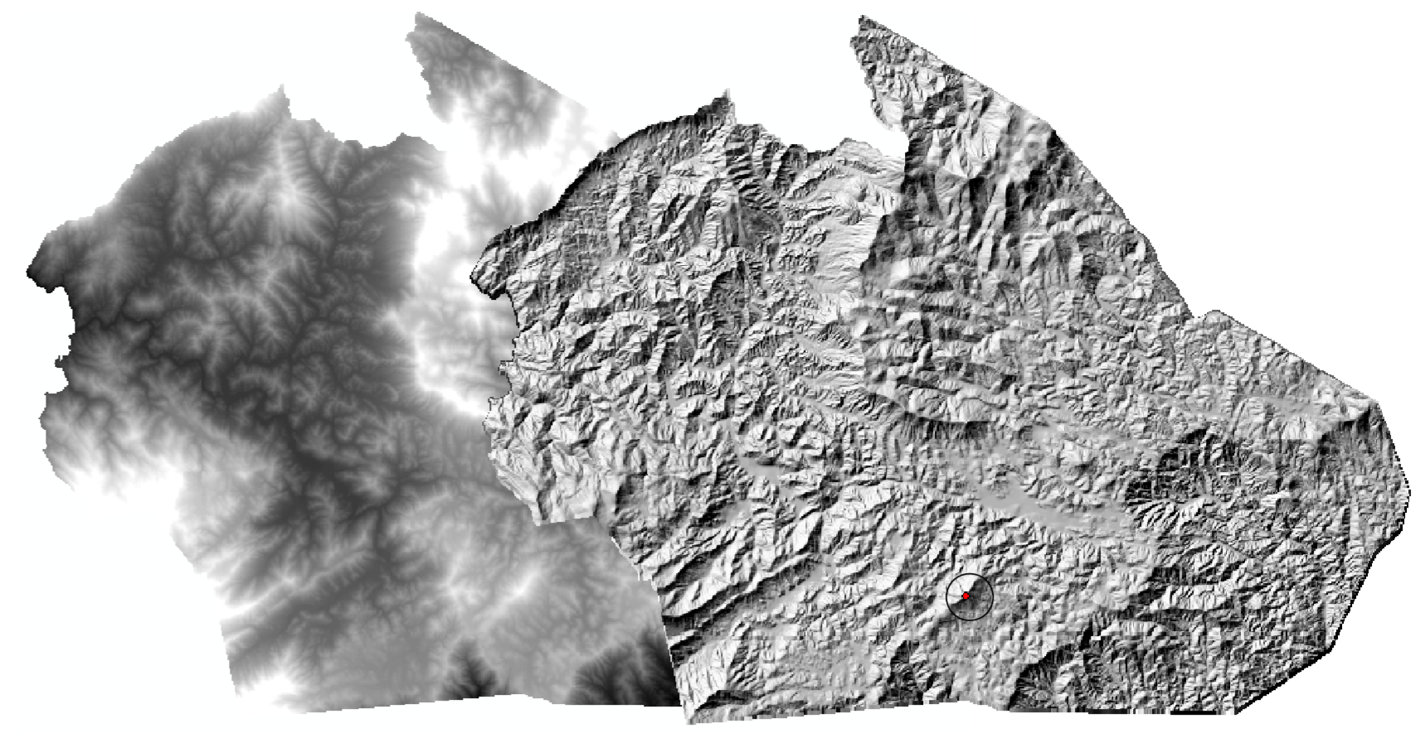
Calculating Single Observer’s Viewshed

Slide 12
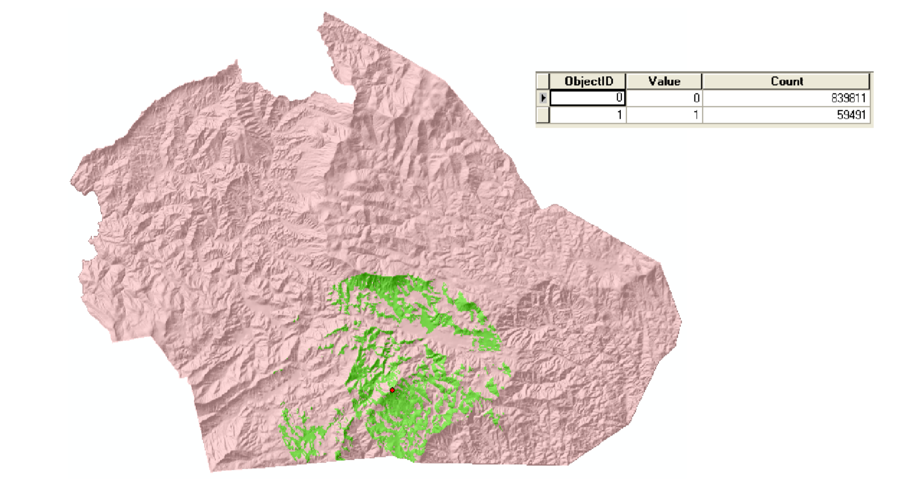
Calculating Single Observer’s Viewshed

Slide 13
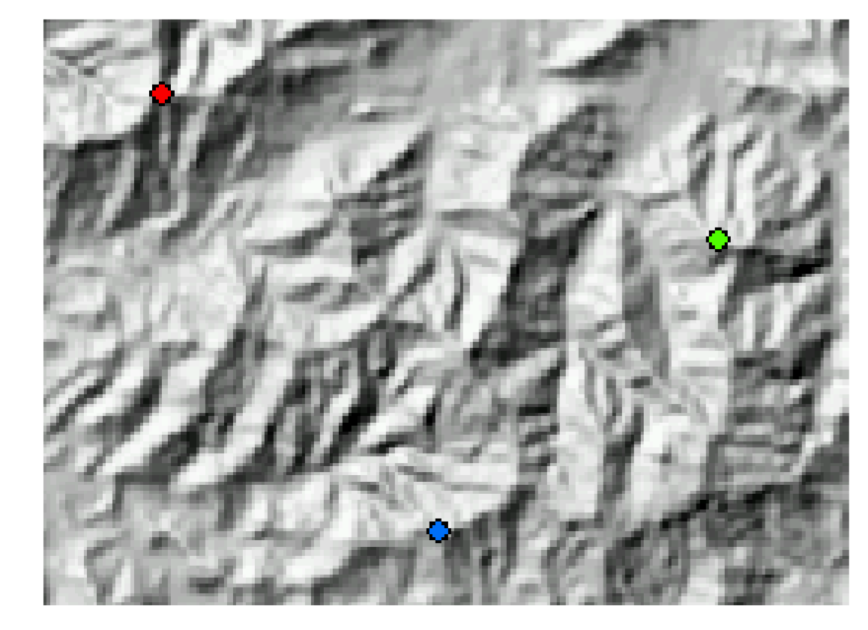
Viewshed Size -- Wind Turbine Visibility
Which wind turbine location is better?

Slide 14
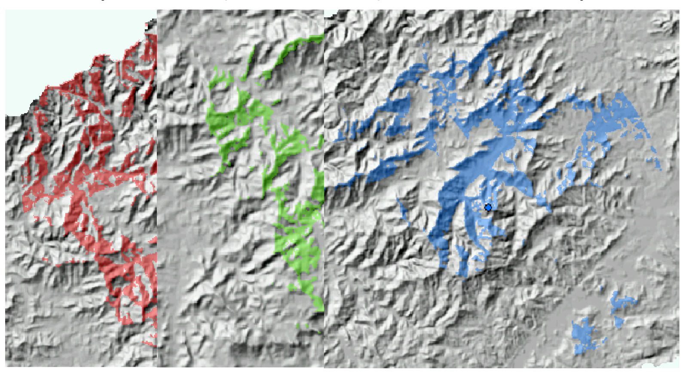
Viewshed Size--Wind Turbine Visibility
Turbine: 50 m; Observer: 1.5 m; Visual distance: 20 mi

Slide 15
Viewshed Size--Wind Turbine Visibility
•Red — 505 km²
Green — 805 km²
Blue — 365 km²

Slide 16
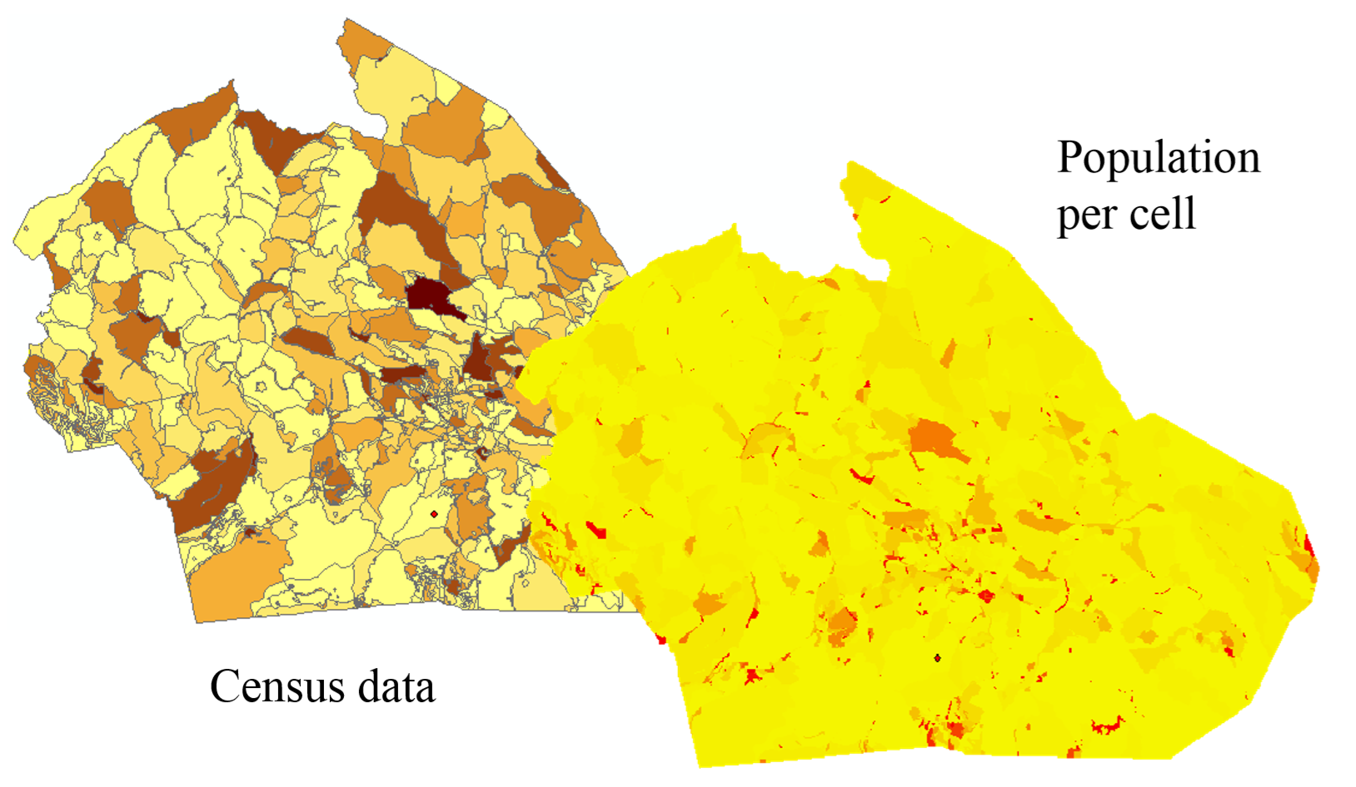
Population Inside A Viewshed

Slide 17
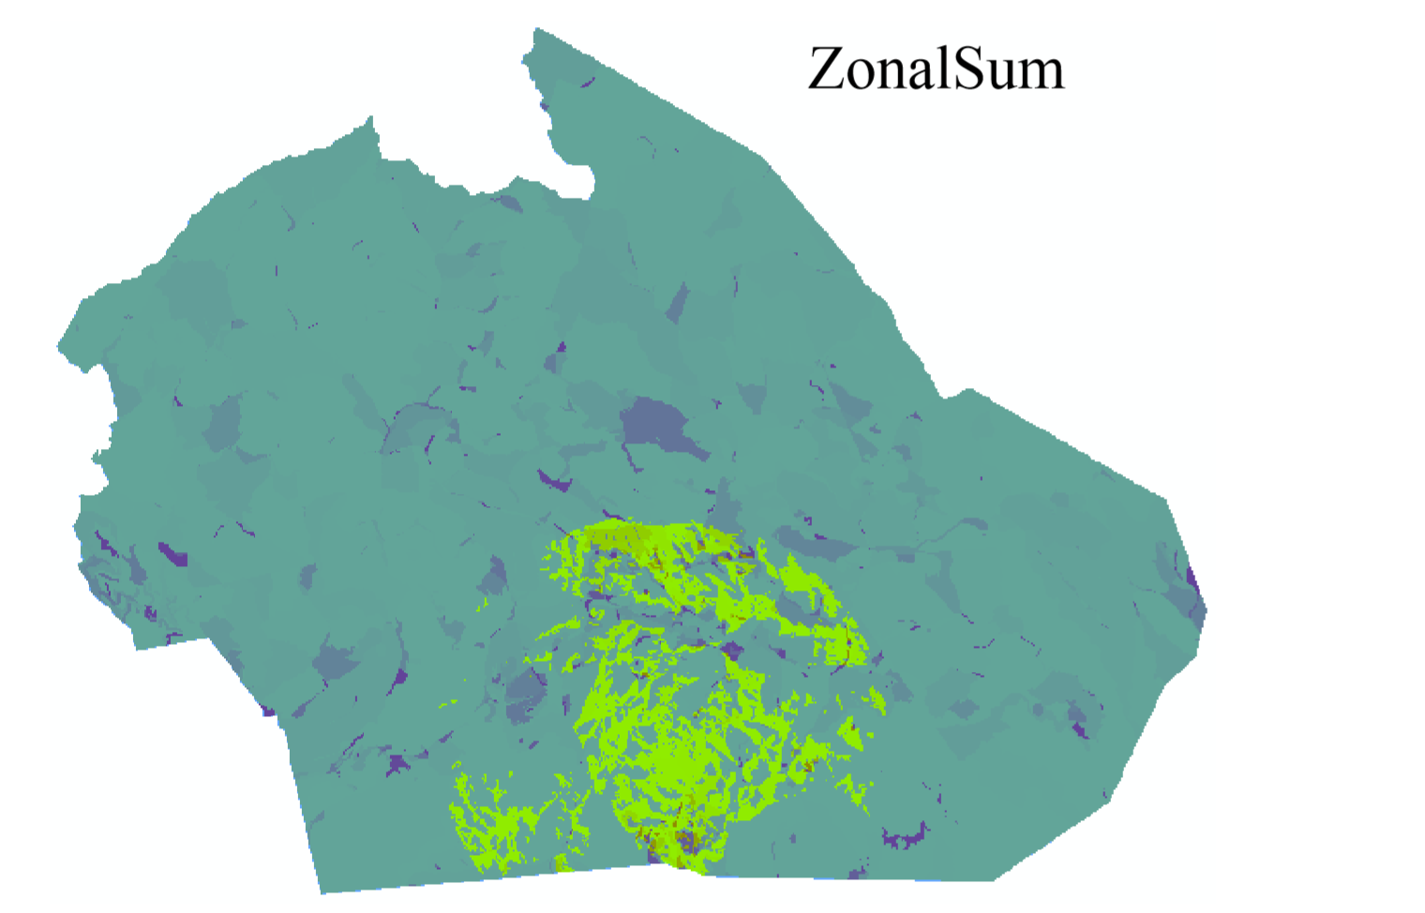
Population Inside A Viewshed

Slide 18
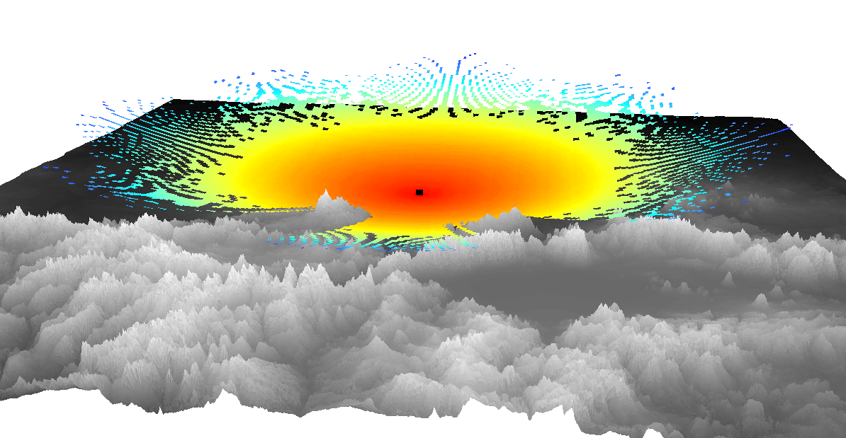
Radio Wave + Visibility
Calculate 3D distance raster
Generate visibility raster
Set invisible cells to NoData

Slide 19
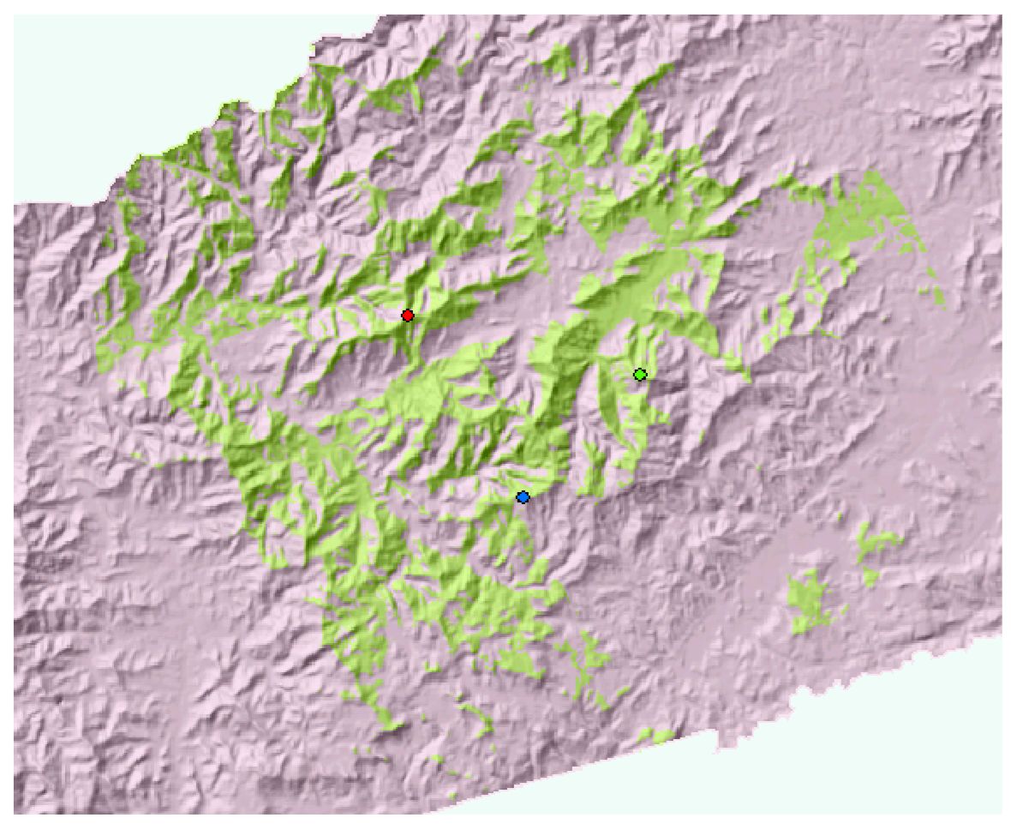
Binary Visibility—Seen by at least one of the observers

Slide 20
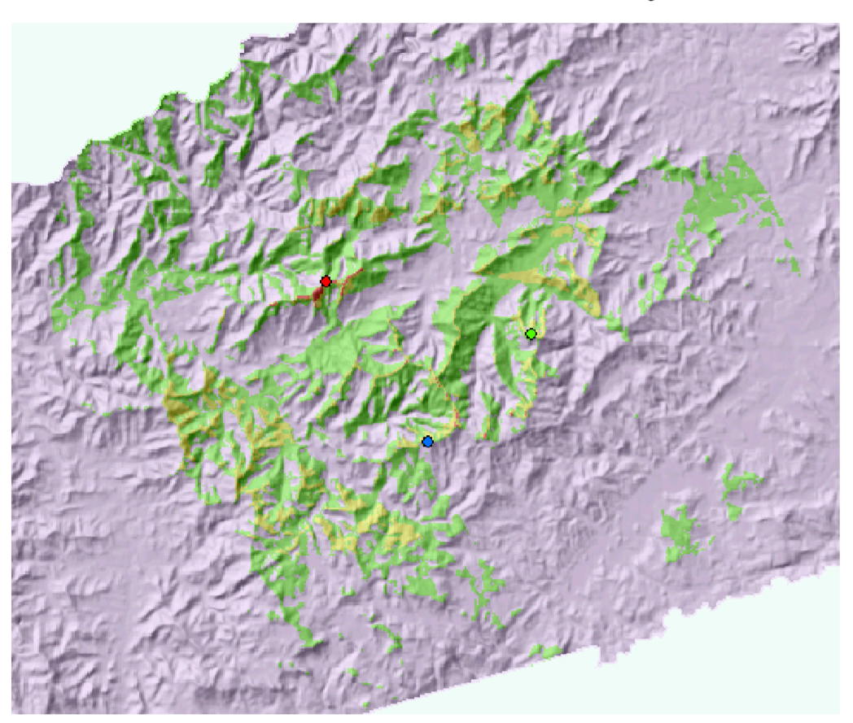
Visibility Frequency or Visual Exposure
How often a location is seen by the observers

Slide 21
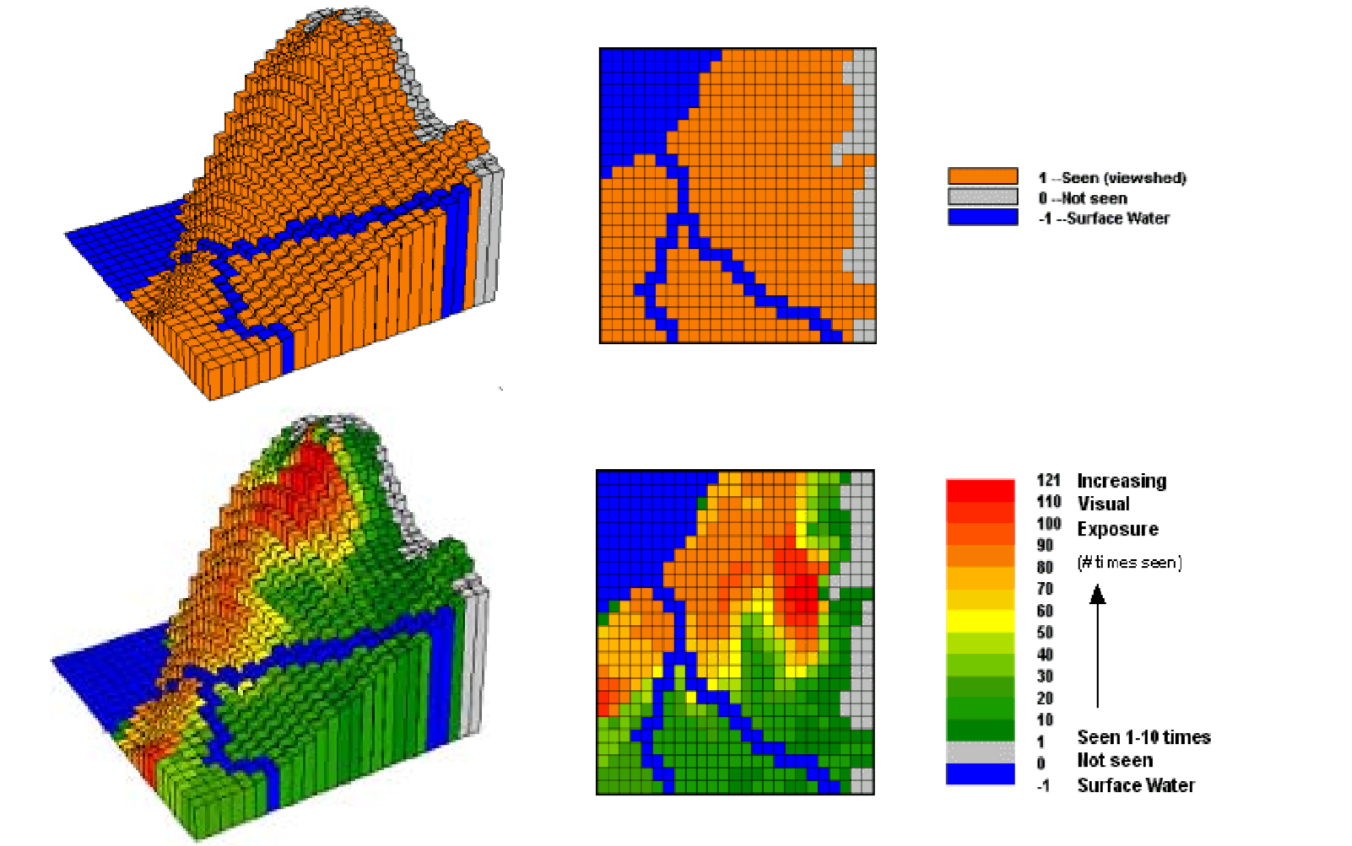
Water Body Visual Exposure Analysis

Slide 22
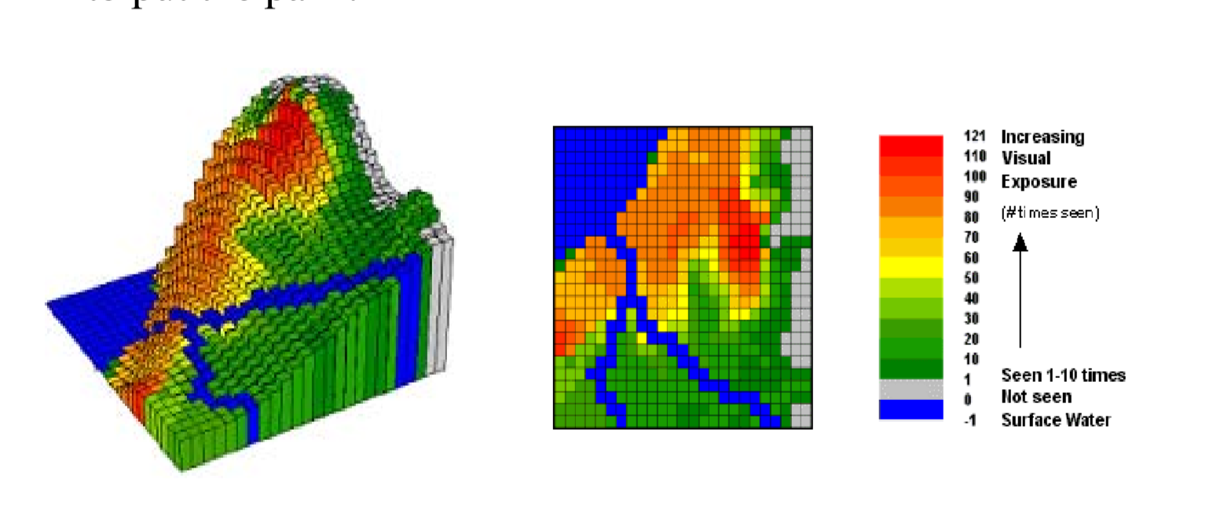
Water Body Visual Exposure Analysis
•Where do you want to put a park which has a great water view?
If the waterbody is a waste dump site, where do you want to put the park?

Slide 23
Exam
The cartographic modeling framework (or map algebra) groups raster analysis operations based on _______
The mathematical complexities of the operations
The number of input layers required by the operations
The spatial scope of the operations
A _____ is a set of connected cells with the same value.
Region
Neighborhood
Zone

Slide 24
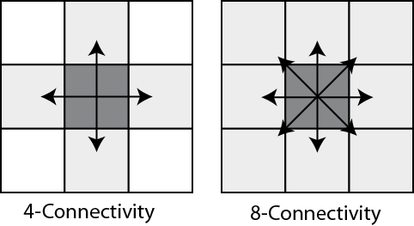
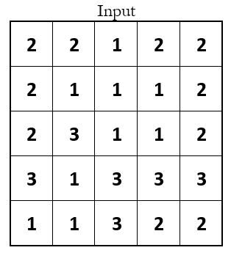
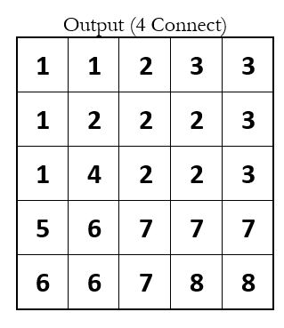
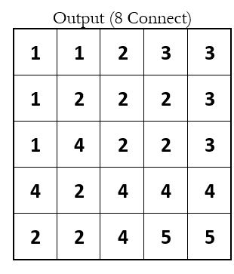

Slide 25
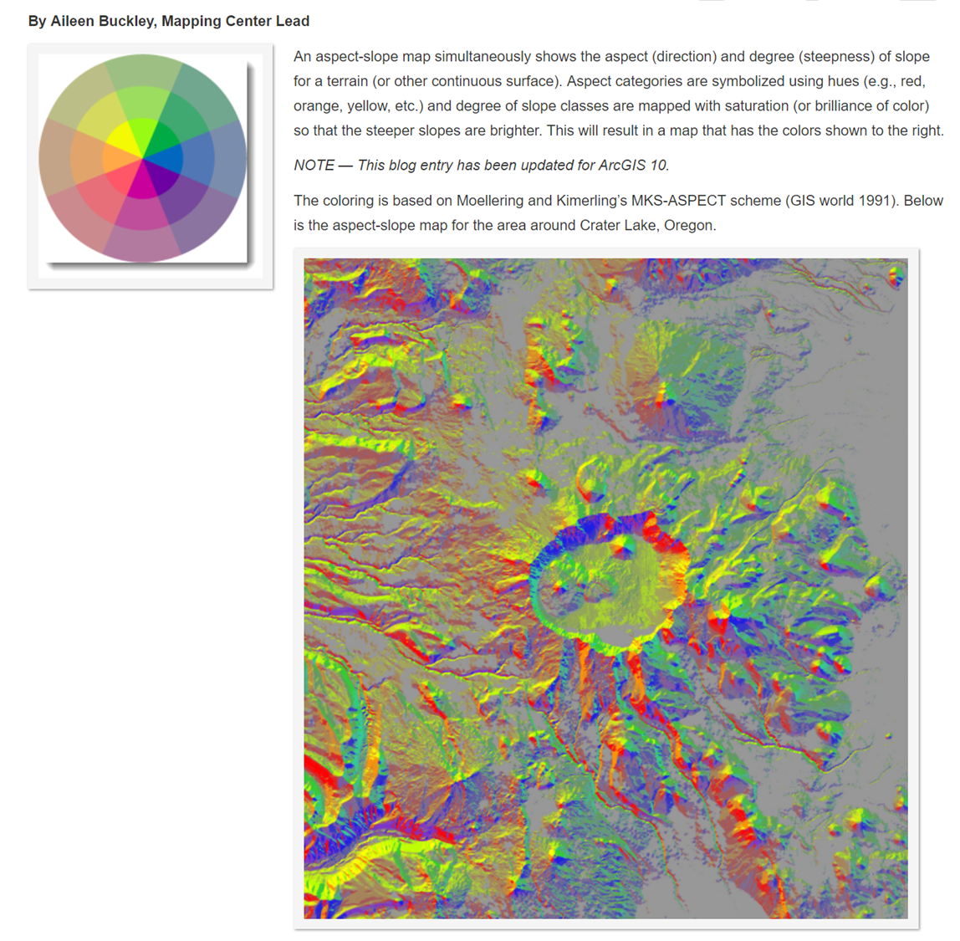
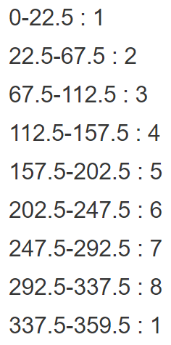
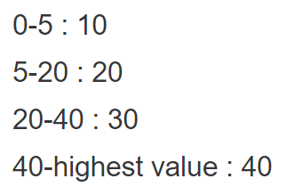

Slide 26
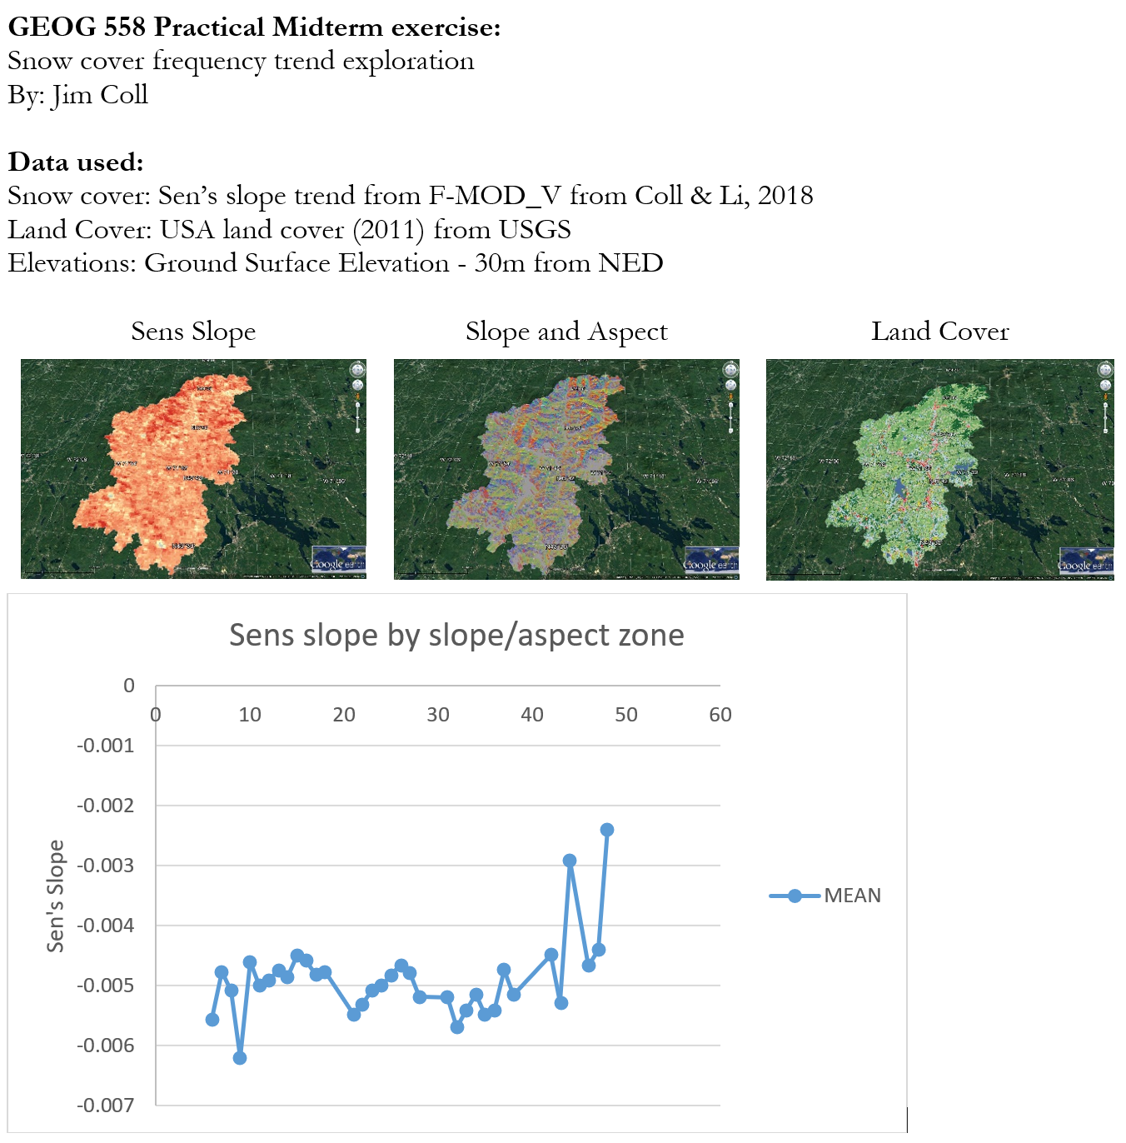
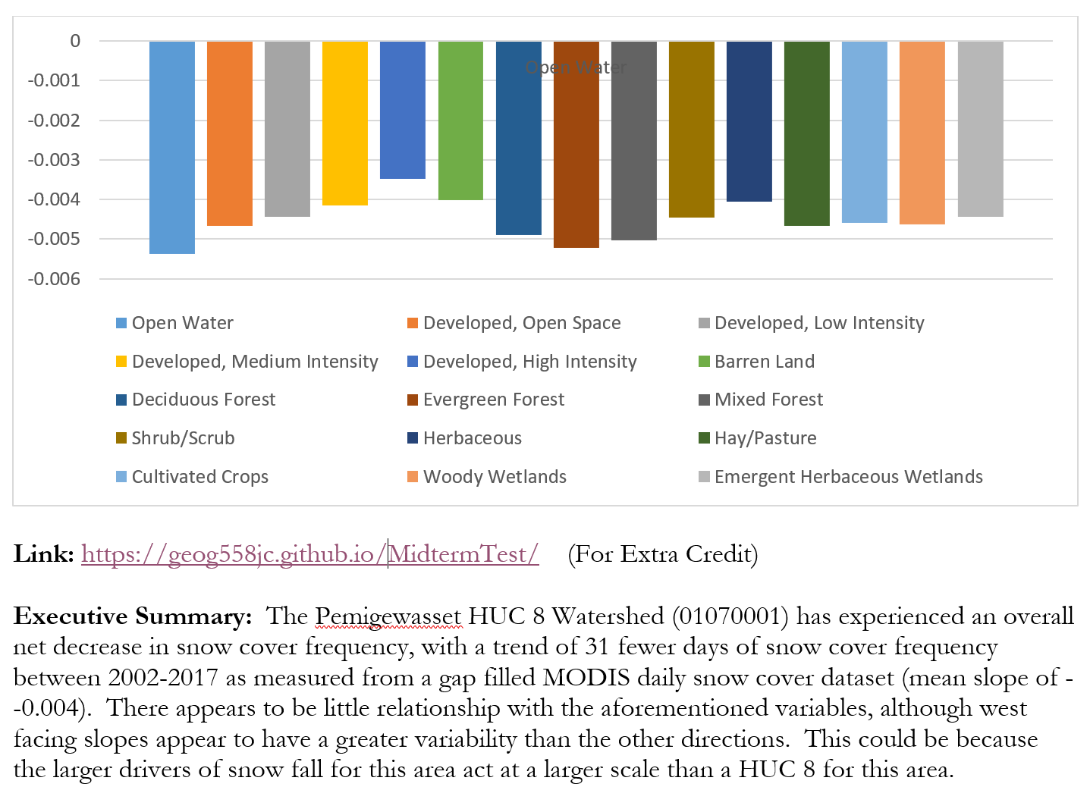
Snow Cover Frequency
Ranking Locations for a certain purpose
Examine alternatives in an objective ways

Slide 27
